Slide 1

A Robust Human Detection System
Guide, Prepared by,
Mrs.R.Saranya,AP/CSE S. ABARNA
IInd Yr.-CSE

Slide 2
INTRODUCTION
Video surveillance receiving tremendous attention. In this field the monitoring of human take place
Human detection is to detect people with number of poses and appearance in complex backgrounds
To track the human with robustness as follows
First requirement to construct appearance model
Then detection and tracking performed to obtain correct trajectory of person

Slide 3
Contd…
Method in human detection are of 2 categories
Signal processing based methods
Machine learning based methods
Human can be detected using frame difference and finding location between human bodies in consecutive frames

Slide 4
OVERVIEW
Image Segmentation
Frame differencing
Aspect Ratio of human
Algorithm
Analysis of datasets
Histogram of gradient
Proposed system
Experiment Result
Future Enhancement

Slide 5
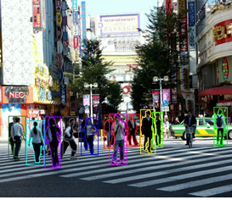
A multiple people tracking algorithm should track the same person at different situation.
If we want to increase the procision the computing time increases and vice versa

Slide 6
DESIGN AND IMPLEMENTATION of CBVR
A.Sampath and A. Nirmala presented CBVR
A. Eweiwi presented work on temporal key images poses of human by using Motion energy images - 91.5 accuracy
Histogram of gradient (HoG) used by obtaining the pose detectors using optical flow of sequence of video frames.
S.Biswas have presented on “Dominating Pose Tablet”
Bipartite graph using dominated poses from different code book by using dominating poses
Tv human interaction,UT Interaction Dataset and hollywood-2 dataset have been used
This approach is limited to two person with constant background

Slide 7
Contd…
Lo and A.Tosi implemented a motion boundary trajectory for human action recognition
HoG ,Histogram optical flow and motion boundary are used as features
It gives an 64.4% accuracy
E.Victor and J.Niebles have introduced a work on spatial-temporal human-object interaction for human action
H.Wang have proposed an work of detecting two persons or person-object interaction
The limitation of this approach is only accuracy of 58.3%

Slide 8
PROPOSED SYSTEMS
The 2D human motion analysis system have been used.
The video used in this experiment is RGB video
Every grayscale images converted into RGB video
Frame differencing is performed in this grayscale
The ith frame is subtracted with i-nth frame to get the objects in motion
If there is any motion in nth frames, then it can be extracted by this method

Slide 9
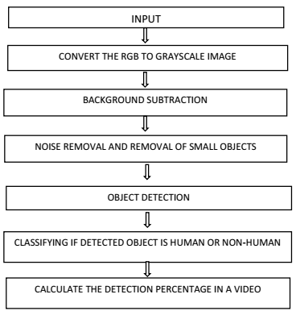
After image pre-processing object localisation is required.
This approach is mainly for detecting moving objects from difference of current frame and reference frame called “Background Image”
Converting grayscale image to binary image
Morphological images have been used to remove imperfections
Calculating the Aspect Ratio of object

Slide 10
ALGORITH
It checks whether there is an object or not.
If there is an object should calculate
Wlratio =(ext1max -ext1min)/(ext2max -ext2min)
where ext1max = right-most-pixel of the object
ext1min = left-most pixel of the object
ext2max = Bottom- most pixel of the object
ext2min = Top-most pixels of the object
If the object is pedestrain,then the aspect ratio comes under 0.3 to 0.75
If objects is non-pedestrain like detecting vehicles ranges from 2 to 3.5

Slide 11
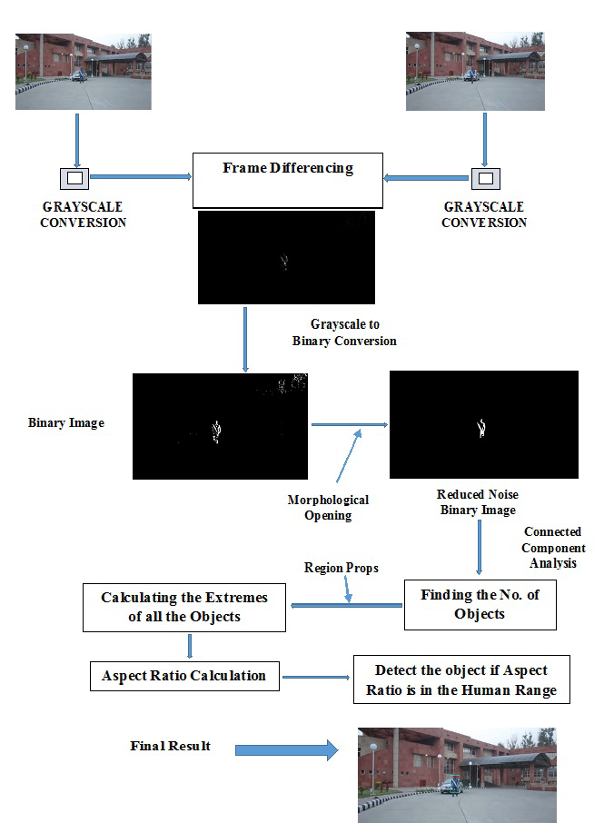

Slide 12
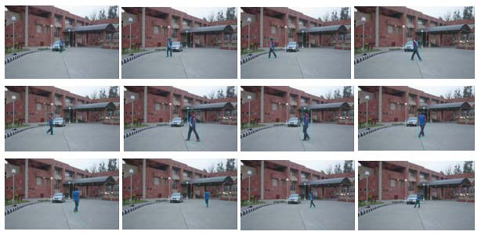
EXEUTION OF THE EXPERIMENT
Frames of the resolution are in 640*360 and sampled at rate of 15 samples/sec.
At first,Human moving in random direction and car in stationary
On second instant,human in fixed direction and car in stationary
On third instance,both car and human are in mation

Slide 13
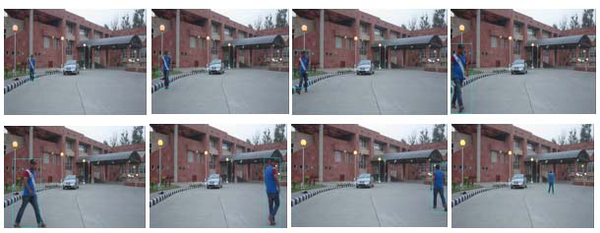
Output of Dataset B.
Here a bounding blue box is generated to detect humans
Output of Dataset C

Slide 14
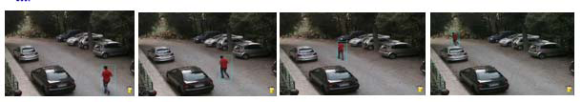
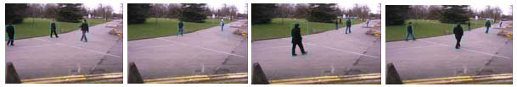
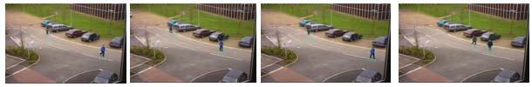
Output of Dataset D
Output of Dataset E
Output of Dataset F
Here in E and F shows the output of multiple pedestrain dataset

Slide 15
Analysis of the algorithm with various datasets
Dataset | Number of Testing Samples | Resolution of Datasets | E4xecution time | Detection Rate
Dataset A | 680 | 640*360 | 177 sec | 87.06%
Dataset B | 502 | 640*360 | 125 sec | 85.66%
Dataset C | 1073 | 640*360 | 342 sec | 74.66%
Dataset D | 78 | 640*480 | 15 se | 98.75%
Dataset E | 437 | 640*480 | 152 sec | 85.67%
Dataset F | 776 | 640*480 | 257 sec | 93.135%

Slide 16
Conclusion
First stage involves the image segmentation applied to motion regions
Second , classifies the segment image is human or non-human based on Aspect Ratio of Human
The overall detection rate is 85% and sometimes detection rate gets reduced drastically when human is occluded in the scene
This accuracy will be helpful for the Future Enhancement using
Texture
Fourier descriptor
Moments of 2D functions,etc,..

Slide 17

Thank You

